Slide 1

Supervised Learning Algorithms
Agenda
Introduction to Random Forest
How Random Forest Works
Understanding Random Forest
Random Forest in Classification and Regression
Advantages & Disadvantages

Slide 2
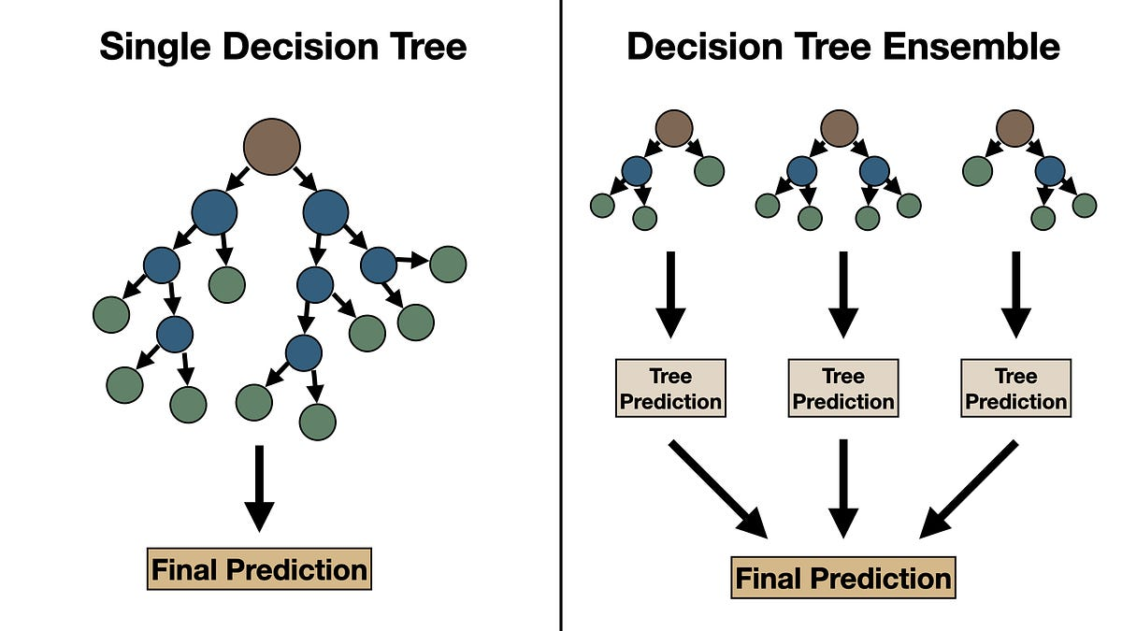
Introduction to Random Forest
Random Forest: A machine learning algorithm that creates multiple decision trees and combines their predictions.

Slide 3
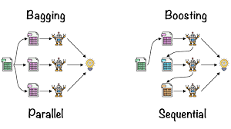
Ensemble Learning: The Core Idea
What is Ensemble Learning?
A technique that combines multiple models to improve performance.
Works on the principle: "The wisdom of the crowd."

Slide 4
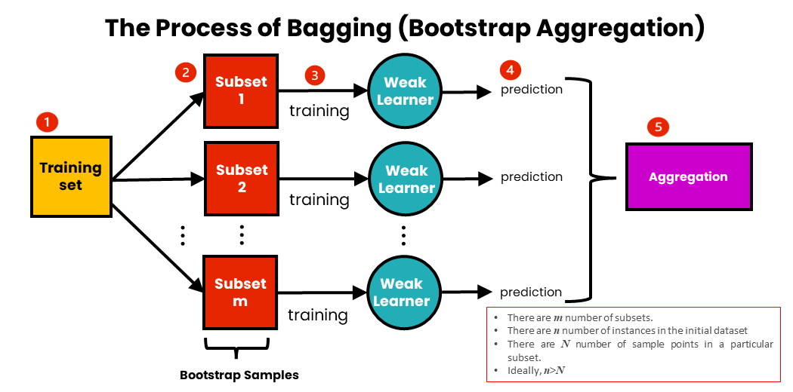
Bagging (Bootstrap Aggregating) Concept

Slide 5
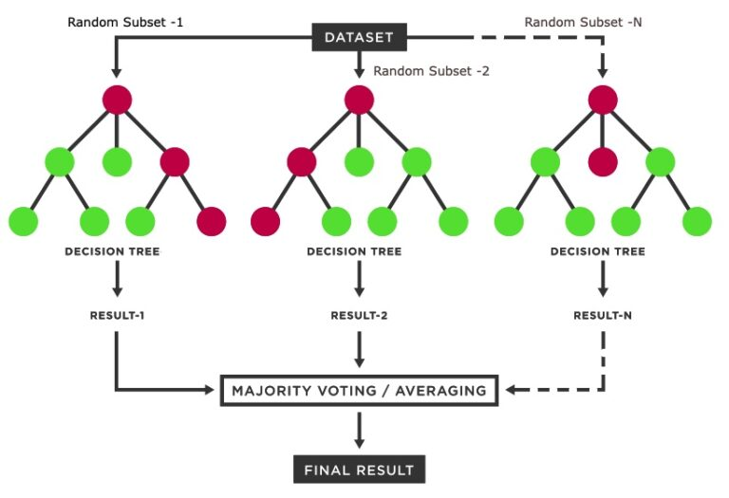
Random Subset of Features

Slide 6
Final Prediction in Random Forest
For Classification:
Each tree predicts a class.
The final prediction is based on majority voting.
Example: Spam detection – 7 trees vote "spam," 3 vote "not spam" → Final prediction: "spam."
For Regression:
Each tree gives a numerical prediction.
The final prediction is the average of all tree outputs.
Example: Predicting house prices – If 5 trees predict [$400K, $420K, $390K, $410K, $415K], the final output = average($405K).

Slide 7
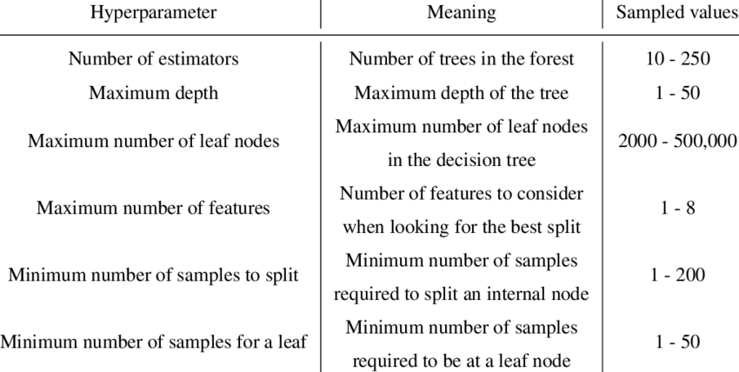
Hyperparameters of Random Forest

Slide 8
Bias-Variance Tradeoff in Random Forest
Understanding Bias and Variance:
Bias: Error due to simplifying assumptions in the model.
Variance: Error due to model sensitivity to small fluctuations in data.
How Random Forest Reduces Variance:
Decision trees alone have high variance (prone to overfitting).
Averaging multiple trees reduces variance while keeping the model powerful.
Balancing Bias and Variance:
Too many trees? Low variance but high training cost.
Too few trees? Faster, but higher variance.
Tuning n_estimators, max_depth, and min_samples_leaf helps balance bias and variance.

Slide 9
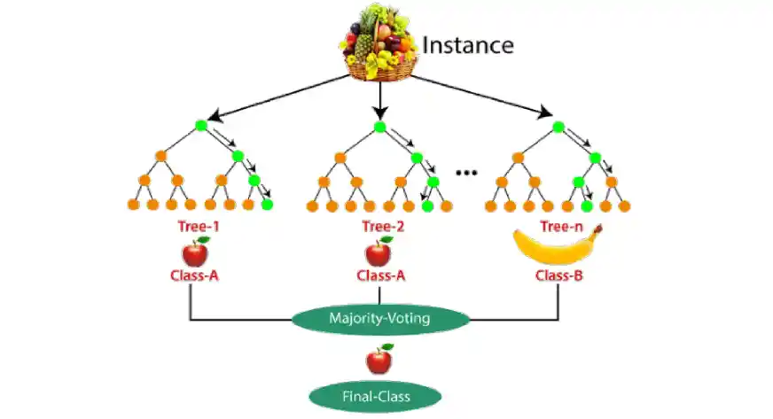
Random Forest for Classification

Slide 10
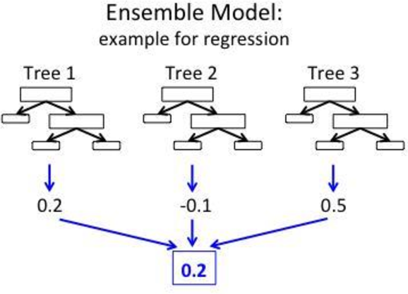
Random Forest for Regression

Slide 11
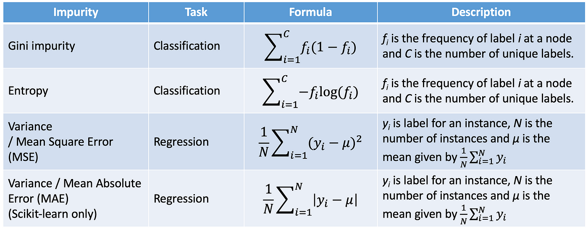
Splitting Techniques

Slide 12
Random Forest vs. Decision Tree
Feature | Decision Tree | Random Forest
Number of Trees | 1 | Multiple
Overfitting | High | Low
Prediction Speed | Fast | Slower
Interpretability | Easy | Hard
Accuracy | Lower | Higher
Computational Cost | Low | High
Handles Missing Data | Poorly | Well

Slide 13
Thank You

